Slide 1
New v.s Existing
Customer
Predicting Customer Churn with Data Driven Approach using MML

Slide 2

Telecommunication Infographics
Business.info
4. Recommendation Business
Business Information
Suggest delivered for business impact
2. Data Structure
5. Modelling
Data Detailed Information
Process step by step making the model
3. Delivered Business Information
6. Recommendation Model
Info about our current business situation
Suggest improvement for the current process

Slide 3
Telecommunication Business
Telecommunications industry is characterized by intense competition, driven by the presence of numerous service providers offering similar products and services.
With low switching costs, customers can easily move between service providers, intensifying the competition further.
Retaining v Acquisition
Acquiring new customers in the telecom industry is considerably more expensive than retaining existing ones. Industry estimates indicate that customer acquisition costs are 5-10 times higher than retention costs.
New Customer = Marketing, Research, Segmenting, Analyzing, Product adjustment, Promotion, etc ( Chance selling 5-20%)
Old Customer = Marketing, Analyzing, Promotion, etc ( Chance selling 60-70% Better)
Source : Business Dasher
According to a McKinsey report, the telecom industry experiences average churn rates ranging from 10% to 25% annually, making customer retention a critical business priority.
Source : Mckinsey Report

Slide 4
Acquisition Customer Flow
Acquisition
2. Customer Onboarding
Attract new customer with many approach
Customer data collection
6. Business Evaluation
3. Service Delivery
Service installment on customer device
Improve business through data
5. Retention and Churn Management
4. Billing and Payment
Assessing data customer
Customer Cost Evaluate

Slide 5
Retention Customer Flow
Acquisition
2. Customer Onboarding
Attract new customer with many approach
Customer data collection
6. Business Evaluation
3. Service Delivery
Service installment on customer device
Improve business through data
5. Retention and Churn Management
4. Billing and Payment
Assessing data customer
Customer Cost Evaluate

Slide 6
1
Revenue
4
Cost Acquisition
Churn Implication
2
Reputation
5
Investment
3
Financial Report

Slide 7
C.1
Churn Financial Implication
Scenario 1 :
The team incorrectly identifies a loyal customer as "at risk," prompting unnecessary retention efforts.
Financial Impact:
1. Retention Incentives: Costs associated with discounts, free upgrades, or other retention strategies.
2. Operational Costs: Expenses related to call center outreach or personalized communication efforts.
Cost Calculation
1. Average cost of retention incentives: $50–$150 (2020 Q2 ISP Company Indonesia) per customer.
2. Call center costs for retention outreach: $10–$30 per interaction.
Example Calculation:
Assuming 10% of 7043 customers are misclassified as FP (704 customers):
1. Minimum loss: 704 × $50 = $35,200
2. Maximum loss: 704 × $150 = $105,600
Source : Academia

Slide 8
C.2
Churn Financial Implication
Scenario 2 :
The model fails to identify a customer who subsequently churns, resulting in lost revenue.
Financial Impact:
1. Direct Revenue Loss: Calculated as the product of Average Revenue Per User (ARPU) and the customer's expected lifetime.
Cost Calculation
1. Global telecom ARPU: Varies by region; for instance, in the Asia-Pacific region, mobile ARPU reached approximately $12.18 in 2024.
2. Average customer lifetime after churn: Estimates suggest an average of 12–24 months
Example Calculation:
Assuming 10% of 7043 customers are FN (704 customers):
1. Conservative loss: 704 × ($10/month × 12 months) = $84,480
2. Aggressive loss: 704 × ($10/month × 24 months) = $168,960
Source : Academia

Slide 9
Churn Analyzing Achievement
Deliver Strategic Business
Executive
Marketing
Data Analyst
Identify Potential Churn
Based on data history
Well Designed Business Proposal Strategies
Recommendation action
Model Machine Learning Prediction Churn
Accurate Prediction using ML
Data Driven awareness
Digitization Process Business
Automation Process
Offer Faster process
Business Strategies
Data Driven
management processes
proactive decisions and strategically allocate resources

Slide 10
Data all about ?
Data Taken
Year 2018 Quartal 3 (Jul-Sep)
Data Total
Data has 7032 (Unique) row & 21 Columns
Data Location
California State (Postal code on ID)
Data Recap Validation
Monthly Charge and Tenure (Monthly)
Services
Phone variete and Internet variate
Customer
We have 7032 Customer Data

Slide 11
Data Representing ?
1 ROW
Data representing 1 Unique Customer (No duplicate)
Data recap per Quartal (Jun-Sep)
Customer
Period
Status
When the customer has paid the bill this month, but does not pay the bill next month
Location
Information
California State based on Postal Code in data Customer ID
Data Include Demographic and service → Data for predicting Churn

Slide 12
More about Churn?
Ericsson ConsumerLab (2023): Found a 72% correlation between 3-month usage decline and subsequent churn in European telcos.
AT&T Retention White Paper (2022): Uses "30-day usage deviation alerts" to flag at-risk customers.
Oracle Communications Data Model: Includes "ARPU (Average Revenue Per User) trend" as a churn predictor.

Slide 13
01 Demographic
[CustomerID], [Gender], [SeniorCitizen], [Partner], [Dependant]
Columns Explanation
02 Location
[CustomerID]
03 Population
21 Columns & 4 Segment
[CustomerID]
04 Services
[CustomerID], [Tenure], [MonthlyCharge], [TotalCharge], [Contract], [Related Service]

Slide 14
Service Related
Internet Service
Streaming Service
[DSL], [FiberOptic]
[StreamingTV], [StreamingMovie]
Online Service
Phone Service
[OnlineBackup], [TechSupport], [DeviceProtection], [OnlineSecurity]
[PhoneService],
[MultipleLine]

Slide 15
Finding

Slide 16
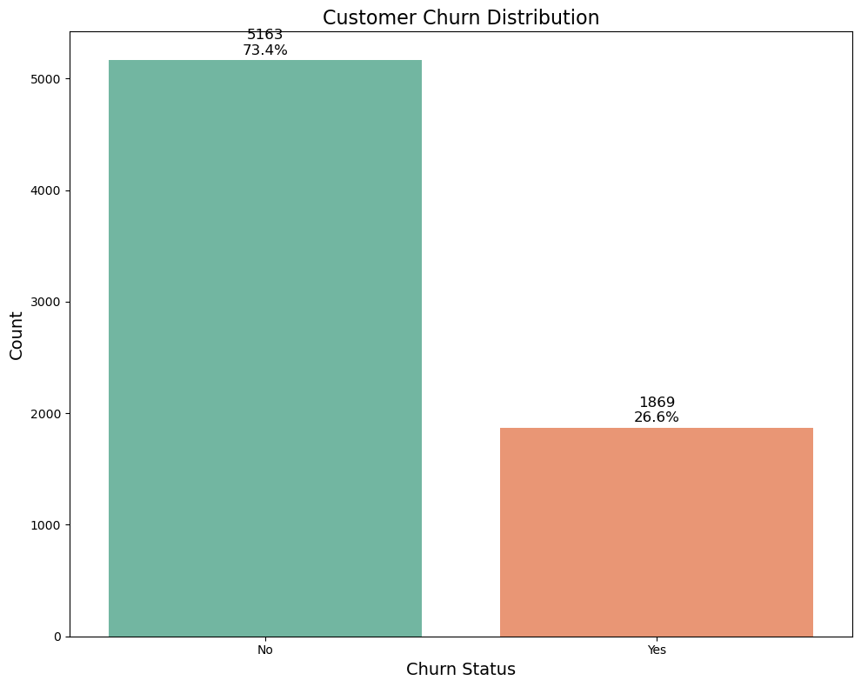
Concerning Churn Rate
The plot shows the percentage of customers who churned vs. those who stayed. Typically in telecom, we see churn rates between 15-25%.
This baseline helps us understand the scale of the problem.
Unscramble

Slide 17
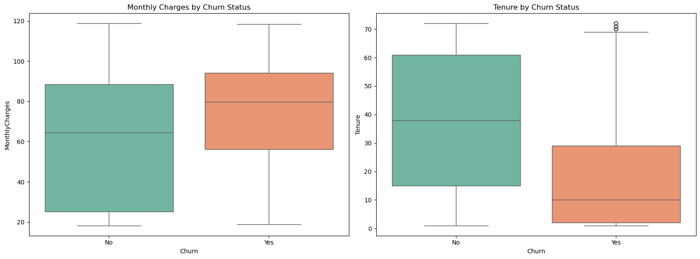
Tending Behavior Customer
Customers who churn tend to have higher monthly charges but lower tenure (shorter time with the company). This suggests that newer customers paying higher prices may be at risk.

Slide 18
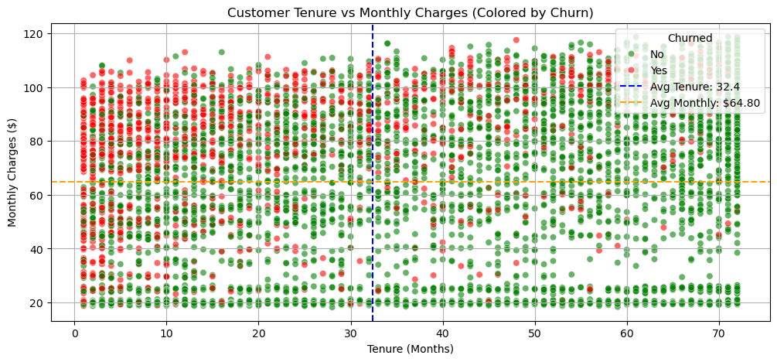
Polarized Relationship Behavior
Early Tenure, High Churn:
Churned customers are mostly within the first 20 months, highlighting the critical period for retention.
High Monthly Charges + Short Tenure = High Risk:
Customers in this segment are most likely to churn, signaling a need for early value delivery.
Loyal Customers Accept Price Variation:
Customers with tenure >50 months show low churn across various price points.

Slide 19
What the Reason ?

Slide 20
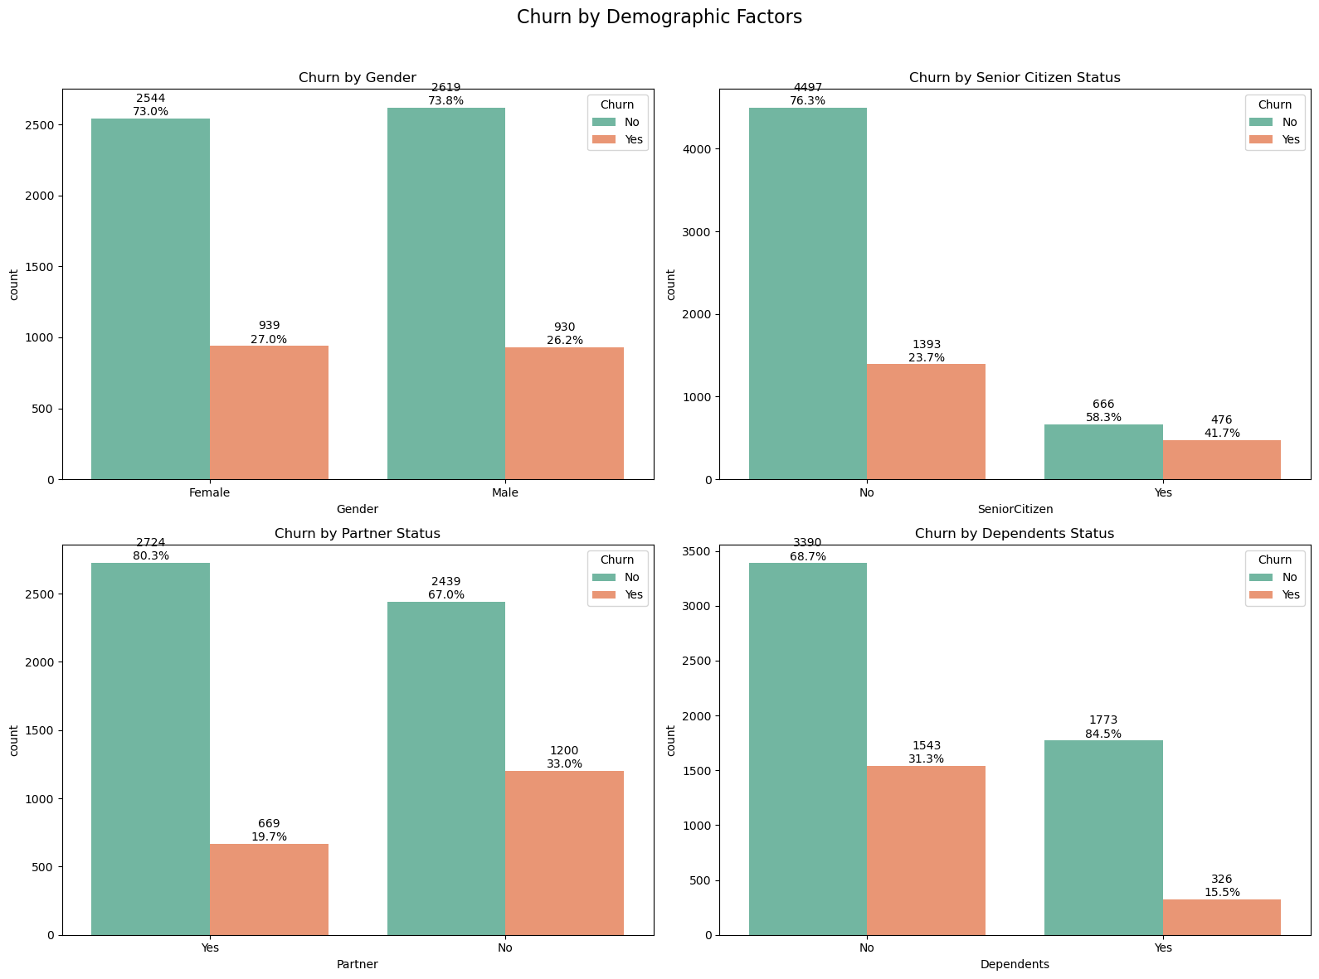
Prospect Customer Focus ? - Demographic View
Senior citizens and customers without partners or dependents tend to have higher churn rates.
This suggests these groups may need special retention efforts.

Slide 21
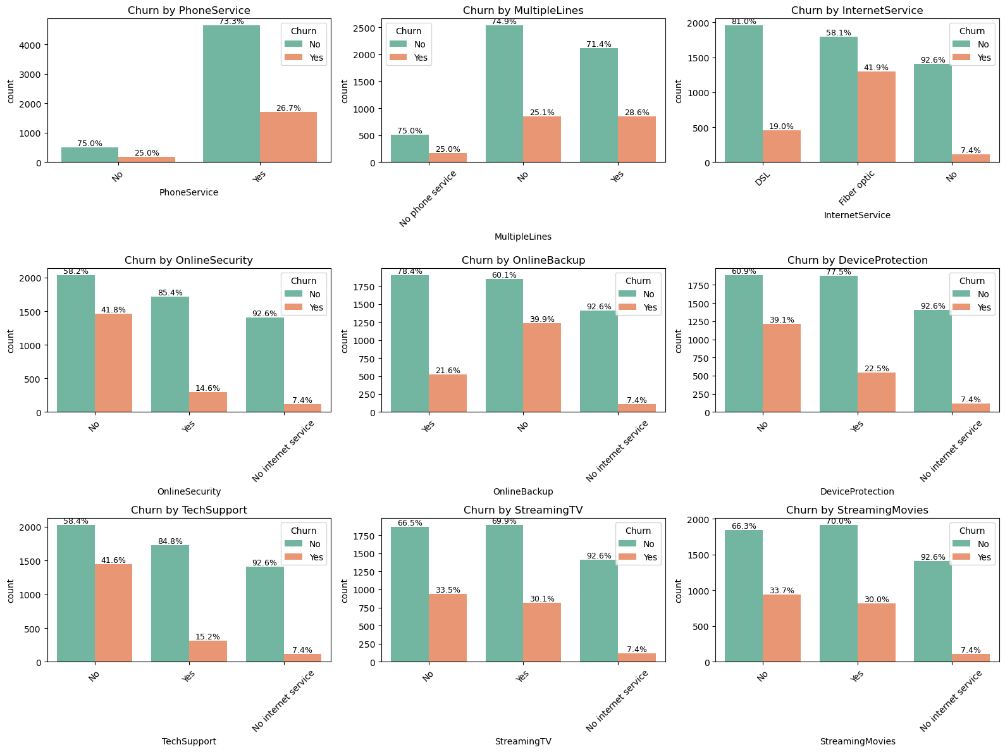
Bundling Strategy Service ! - Service View

Slide 22
Bundling Strategy Service ! - Service View
Customers with Fiber optic internet service and those without online security, tech support, or device protection have significantly higher churn rates. These service factors appear to be strong predictors of churn.

Slide 23
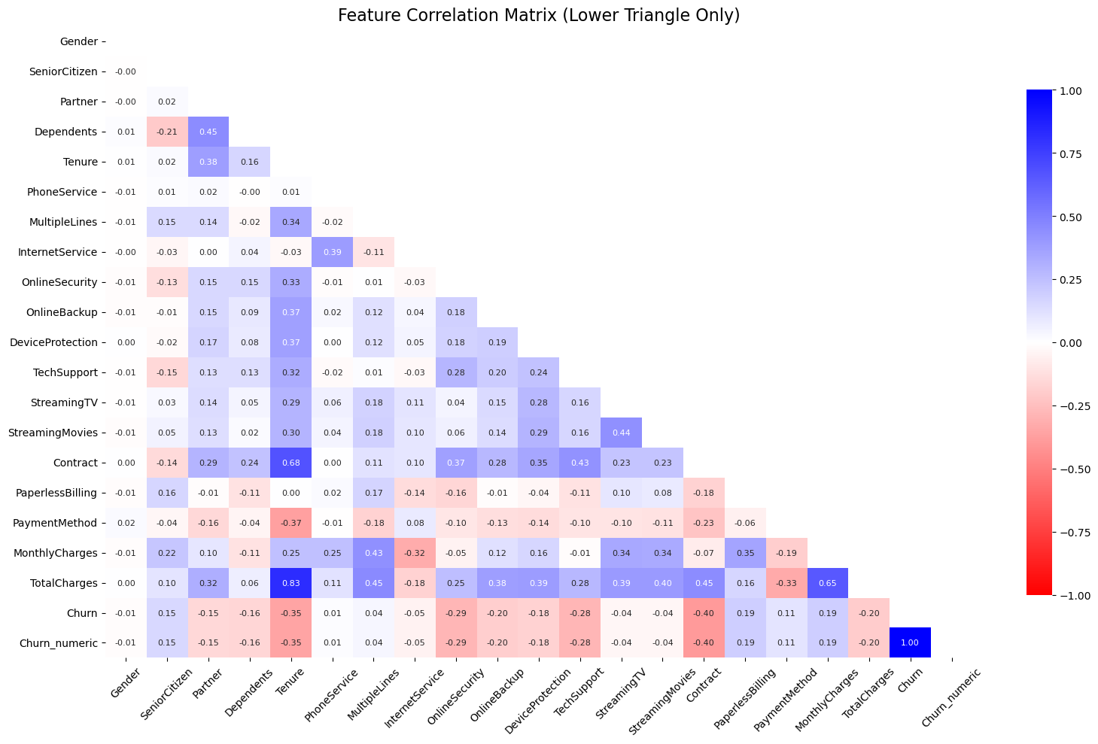
Influential Bundling Strategy ! - Service View
The heatmap shows strong correlations between churn and factors like contract type, internet service type, and online security. These should be prioritized in retention strategies.

Slide 24
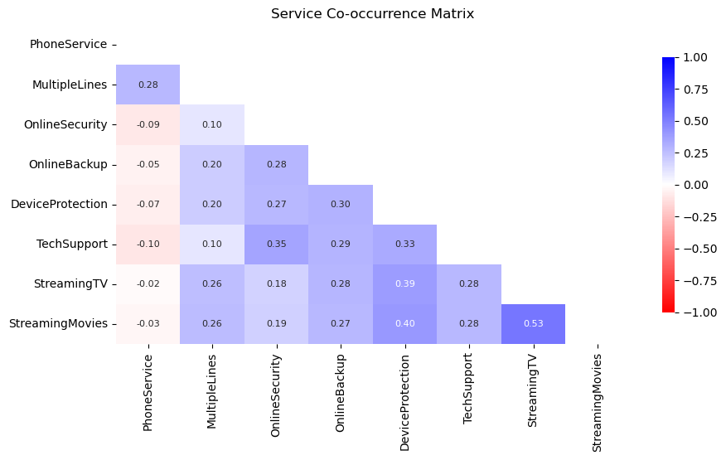
Consideration Bundling Strategy ! - Service View
StreamingTV & StreamingMovies (0.53): Strong bundling potential—users often subscribe to both.
DeviceProtection & Online Services (0.30–0.40): Ideal upsell for tech-savvy customers.
OnlineSecurity & TechSupport (0.35): Bundle opportunity for digitally cautious users.
MultipleLines & Streaming (0.26): Appeals to households needing multi-user access.

Slide 25
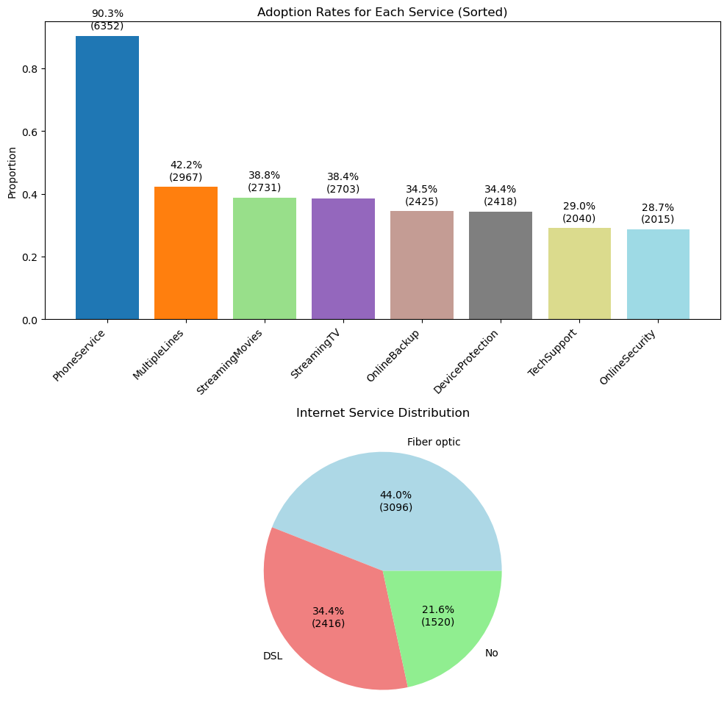
Adoption Product Service ! - Service View
Findings:
1. PhoneService adoption: ~90%
2. MultipleLines adoption: ~42% of phone service users
3. OnlineSecurity: ~29% adoption
4. OnlineBackup: ~34% adoption
5. DeviceProtection: ~34% adoption
6. TechSupport: ~29% adoption
7. StreamingTV: ~38% adoption
8. StreamingMovies: ~39% adoption

Slide 26
Adoption Product Service ! - Service View
Capitalizing on the high adoption of Phone Service and the growth potential in OnlineSecurity, TechSupport, and streaming services can significantly boost revenue.
By strategically bundling services and targeting specific customer segments, the business can maximize customer lifetime value and enhance service adoption rates effectively.

Slide 27
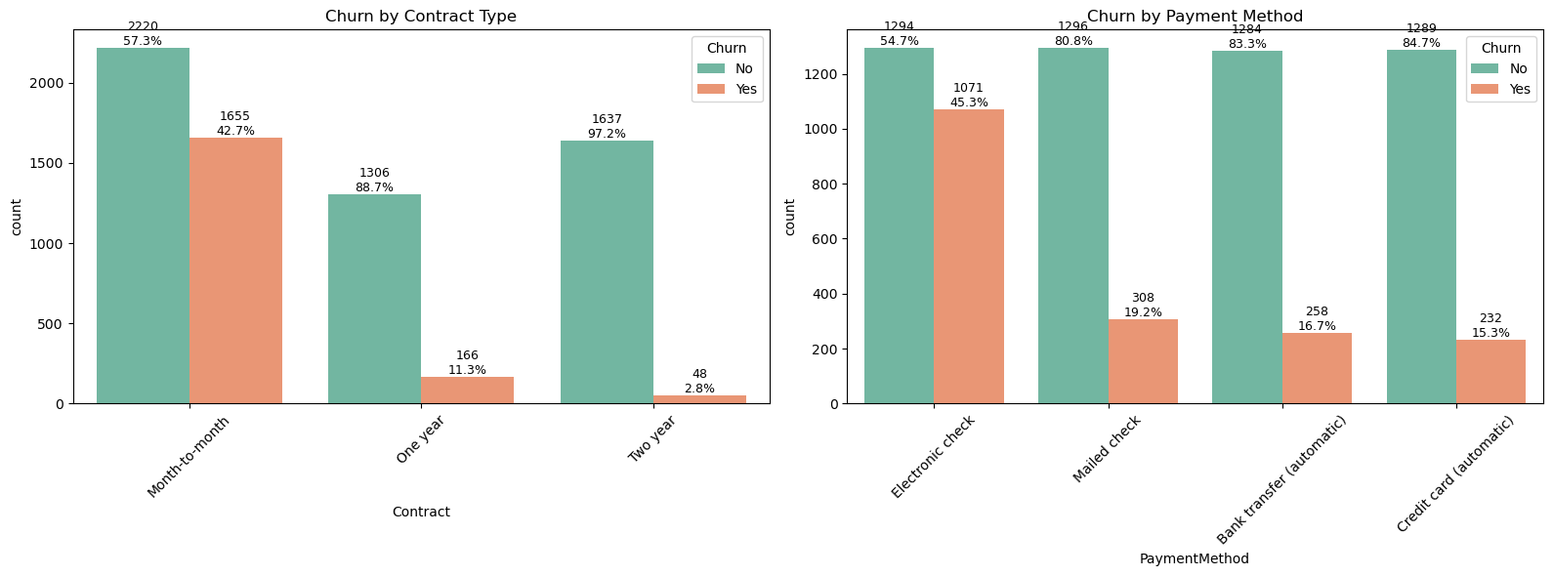
Stabilize Payment ? - Contract & Payment View
Month-to-month contracts and electronic check payment methods are associated with much higher churn rates. Customers with longer-term contracts are more stable.

Slide 28
Business Proposal

Slide 29
Bundling Package
Bundling Services
"Stream Saver Bundle" (30 Mbps Internet + Streaming TV/Movies at IDR 320,000/month)
Add a free 3-month trial of OnlineSecurity to reduce churn.
Target: Young adults without dependents or partners.
Reference: IndiHome 30 Mbps Internet + TV package priced at IDR 320,000/month.
"Family Shield Bundle" (50 Mbps Internet + TV + Phone at IDR 465,000/month)
Include free device protection for the first year.
Target: Families with children (lowest churn segment).
Reference: IndiHome 50 Mbps Internet + TV + Phone package priced at IDR 465,000/month.
Telkomsel - IndiHome
Add-On Services
OnlineSecurity Add-on: IDR 50,000 – 70,000/month.
Premium Streaming Access (Netflix, Disney+): IDR 50,000 – 100,000/month.
Mobile Data Add-on (for bundles like XL SATU): IDR 50,000 – 85,000/month
Telkomsel - IndiHome

Slide 30
Payment Package
Stepped Pricing
Base Plan
IDR 265,000 – 295,000 (Internet only - 30 Mbps).
Reference: IndiHome 30 Mbps Internet-only package priced at IDR 265,000/month.
Preferred Plan
IDR 320,000 – 370,000 (Internet + TV - 30 Mbps).
Reference: IndiHome 30 Mbps Internet + TV package priced at IDR 320,000/month.
Premium Plan
IDR 465,000 – 515,000 (Internet + TV + Phone - 50 Mbps).
Reference: IndiHome 50 Mbps Internet + TV + Phone package priced at IDR 465,000/month.
Telkomsel - IndiHome
Payment Method
Offer 10% - 20% discount for converting month-to-month to 1-year contract.
"Lock-and-Save" program: Price guarantee for 2-year signups.
Telkomsel - IndiHome

Slide 31
Customer Care
Retention Strategy
Churn Risk Response
Identify high-spending customers (spending > IDR 500,000/month) showing signs of churn.
Offer free service upgrades for users with tenure exceeding 12 months.
Loyalty Rewards
Provide monthly rewards or exclusive perks for customers spending above IDR 500,000/month.

Slide 32
Technology Awareness
Using Model Machine Learning
Idea
Efficient
Focus
Application
Company Needs for effective way to predict customer churn/not
Old way need longer time while New way are faster
Based on customer behavior/history as baseline for prediction
Using deploy model to predict batch data

Slide 33
Modelling Process
1
6
Define
6. Performance
Determine Feature and Label for modelling
Show how model works and cost evaluation
2
5
2. Splitting Data
5. Model Tuning
Dividing data into data test & train
Optimize the best model
3
4
3. Encoding
4. Cross Validation
State the process based on Feature type
Choosing the base algo for modelling

Slide 34
Which data are Feature / Label
Feature
(X)
Detail | Feature | Explanation
19 Columns Remaining | Categorical Data | Data consist unique value
 | Gender, SeniorCitizen, Partner, Dependents, PhoneService, MultipleLines, InternetServices, OnlineSecurity, OnlineBackup, DeviceProtection, TechSupport, StreamingTV, StreamingMovies, Contract, PaperlessBilling, PaymentMethod,
7032 Data Remaining | Numerical Data | Data consist number
 | Tenure, MonthlyCharges, TotalCharges
Label
(y)
1
Supervised Model | Churn
Categorical Model (consist of Yes/No)

Slide 35
Grouping data into Test & Train Data
In the splitting process, several parameters need to be explained, including:
Test Size :
Determines the proportion of data to be used as test data, with the remainder used for training. In this modeling, the data split will be as follows:
Train : 80% of the dataset
Test : 20% of the dataset
The training set is set to 80% so that the model can learn more data, ensuring that when the model is tested on a new dataset in the future.
Random State :
Ensures that the data split results remain consistent (reproducible) with every execution of the code. In this modeling, the random state will be set as follows:
Random state = 9
The number 9 is chosen based on the number of features used in this model. This selection is based on a journal titled:
"Random State Parameter Undersampling for Handling Imbalanced Data in the Random Forest Algorithm."
stratify:
Ensuring that the division of the training and test data retains the same class proportion distribution as in the original dataset (usually for classification data). In this modeling, stratify will be used as follows
stratify = y.
2

Slide 36
3
Adjust data with PreProcess
Encoding | Feature | Detailed
Onehot Encoding | All Categorical Feature | All data has unique value below 4
All remaining columns are going processed as it is
One Hot Encoder
Robust Scaler
Passthrough
Scaler | Feature | Detailed
Robust Scaler | All Numerical Feature | Suitable preventing mishap prediction over outlier
Data in column need to be processed as it helps the model see how different data points (like age, income, contract type) relate to each other.

Slide 37
The best of all Algo Model
4
Interpretable Model | Black box Model | Ensemble Model
A model whose prediction results can be explained directly and understood by everyone. | A model so complex that it is difficult to explain how the model makes decisions. | A model that combines several simple models (weak learners) to form a stronger model.
LogisticRegression, DecisionTreeClassifier | GradientBoosting, BaggingClasifier, AdaBoostClassifier, CatBoostClassifier | Voting (Log, Tree, Gboost) Stacking (log, Tree, Gboost)
Mention
Scenario 1 (FP) : The team incorrectly identifies a loyal customer as "at risk," prompting unnecessary retention efforts.
Company Lost ($105,600)
Scenario 2 (FN) : The predict fails to identify a customer who subsequently churns, resulting in lost revenue.
Company Lost ($168,960)
In telecom churn prediction, both False Positives (FP) and False Negatives (FN) incur significant costs, but FN is far more damaging due to the irreversible loss of high-value customers.
F2 Score
Recall > Precision

Slide 38
The best of all Algo Model
4
Using Cross Validation method to find the best algorithm, we get result such as:
Model | Parameter | Result
LogisticRegression | RandomState = 9 | F2 = 57 % | Std = 0,019
AdaBoostClassifier | RandomState = 9 | F2 = 56 % | Std = 0,038
StackingClassifier | RandomState = 9 | F2 = 56 % | Std = 0,036
Logistic Regression is very suitable for churn prediction. In fact, it is one of the most common and recommended models for classification problems.
braze

Slide 39
What the rights Configuration ?
Model | Parameter | Result
Before Configuration
LogisticRegression | RandomState = 9 | F2 = 57 % | Std = 0,019
After Configuration
LogisticRegression | RandomState = 9 SamplingStrategy = 0,5 Model_Solver = Liblinear Model_Penalty = L1 | F2 = 63 % | Std = 0,010
5
Additional configurations on Logistic Regression significantly improved the model’s accuracy, especially on F2-score, which places more emphasis on recall its very important in the context of churn prediction (it’s better to capture all potential churn even if there are false positives).
In addition, the decrease in standard deviation from 1.9% to 1.0% indicates that the model is more stable and consistent across multiple data splits (folds).

Slide 40
Can the Model Works ?
We compare the Confusion Matrix before and after Hyperparameter Tuning, with the following results:
--------------------------------------------------------------------------------------------------------------------------------------------
| Before | After
--------------------------------------------------------------------------------------------------------------------------------------------
Number of Correct Claim Predictions (TP) : 922 873
Number of Correct Non-Claim Predictions (TN) : 199 237
Number of Missed Claims (FN) : 175 137
Number of False Alarms (FP) : 111 160
Then, we calculate the cost impact to evaluate whether the model can reduce company losses,
with the cost details as follows:
FP (False Positive): Company incurs losses due to mismanaged cycle money, causing
Cost: $150
FN (False Negative): Company suffers losses from claim disputes and loss of customer trust,
Cost: $240
Cost evaluation is as follows:
Before Tuning
(FP x $ 87,803,750,000) + (FN x $ 540,803,750,000)
Total Company Loss : $. 58650
After Tuning
(FP x $ 87,803,750,000) + (FN x $ 540,803,750,000)
Total Company Loss : $. 56880
Difference (Reduction) : $. 58650 - $. 56880
Total Savings : $. 1770
Total Savings (%) : 1.53 %
Based on the cost evaluation, it can be seen that
the company successfully reduced losses caused by wrong predictions by $. 1770.
Thus, the model can be considered SUCCESSFUL in achieving the objectives:
Identifying patterns and risk factors determining claim likelihood,
Helping the company manage claims more effectively,
Creating opportunities to improve operational efficiency,
Maximizing policy profitability, and
Providing more personalized and relevant customer experiences while reducing company losses due to costs.
6

Slide 41
Can the Model Works ? ( 4 sample )
Feature | Coef
Robust_Tenure | (-) 2,89
Onehot_Contract_Two_Year | (-) 1,25
Robust_TotalCharge | (+) 1,17
Onehot_InternetService_FiberOptic | (+) 1,08
Model Explanation influential features based on their coefficients:
Tenure has the strongest negative coefficient (-2.89), which means customers who have been subscribed longer are far less likely to churn.
This aligns with business intuition — loyal customers are typically more satisfied.
Customers on a Two-year contract show a strong negative effect (-1.25), indicating they are more committed and less likely to leave.
This highlights the importance of offering long-term contracts to reduce churn.
TotalCharges has a positive coefficient (+1.17), suggesting that customers who have paid more over time might actually be more likely to churn.
Although this may seem counterintuitive, it could indicate early high spenders who later became dissatisfied.
Customers with Fiber optic internet service have a positive coefficient (+1.08), meaning they are more likely to churn.
This might be due to higher expectations for speed and reliability, and if those expectations aren't met, they may switch providers.
6

Slide 42
Model Improvement

Slide 43
Evaluation Model
Conclusion 2
Cost Evaluation Summary
Baseline cost (no model): $154,950
Cost before tuning: $58,650
Cost after tuning: $56,880
Cost reduction: $98,070 (~63%)
Model effectively reduces company losses and improves decision-making.
Conclusion 1
The optimized Logistic Regression model achieved an F2 Score of 0.63, an improvement from the previous score of 0.57.
This increase reflects better generalization and an improvement in recall, especially important in reducing False Negatives, which are the costliest errors in this business case.
False Negatives reduced from 175 to 137 (down 38)
False Positives increased from 111 to 160 (up 49)
Total company loss decreased from $58,650 to $56,880
Total savings achieved: $1,770 (1.53%)

Slide 44
Improvement Model
Model Fit Analysis
The model used is Logistic Regression, which is interpretable and low-complexity by design.
The increase in F2 Score from 0.57 to 0.63 suggests improved generalization after tuning.
The reduction in False Negatives and slight increase in False Positives indicates a reasonable trade-off, not overfitting.
Since there's no access to train/test split scores, we cannot confirm overfitting — but no evidence suggests it.
Given that Logistic Regression is less prone to overfitting and shows better performance on new data
Recommendation Improvement Model
Proceed with the current Logistic Regression model as a cost-effective and interpretable solution.
Deploy the model into a production pipeline with regular evaluation and retraining.
Reguler Update to understand and updating key risk drivers in claim prediction.
Simplify the process by using AI agent (ex N8N) for automaton process from start to end data

Slide 45
Wall Limitation

Slide 46
Lacking of Information
Lack of Specific Subscription Time Information
The dataset does not include any timestamp information such as the exact date or month when customers subscribed. This limits the model's ability to detect seasonal trends or time-based churn patterns.
Missing Historical Behavior Data
The data is a snapshot in time and does not capture customer behavior over a historical period. Without time-series data, the model cannot observe changes in behavior that might signal an impending churn (e.g., recent service downgrades).
TotalCharges Column Initially Contained Missing Values
Although cleaned, the TotalCharges feature originally had missing values. If not properly handled during preprocessing, this could reduce the reliability of the model's predictions.
Limited Feature Set
Important features such as customer service interactions, complaints, service usage patterns (daily/monthly), or customer satisfaction feedback are not available, although these could significantly enhance churn prediction.

Slide 47
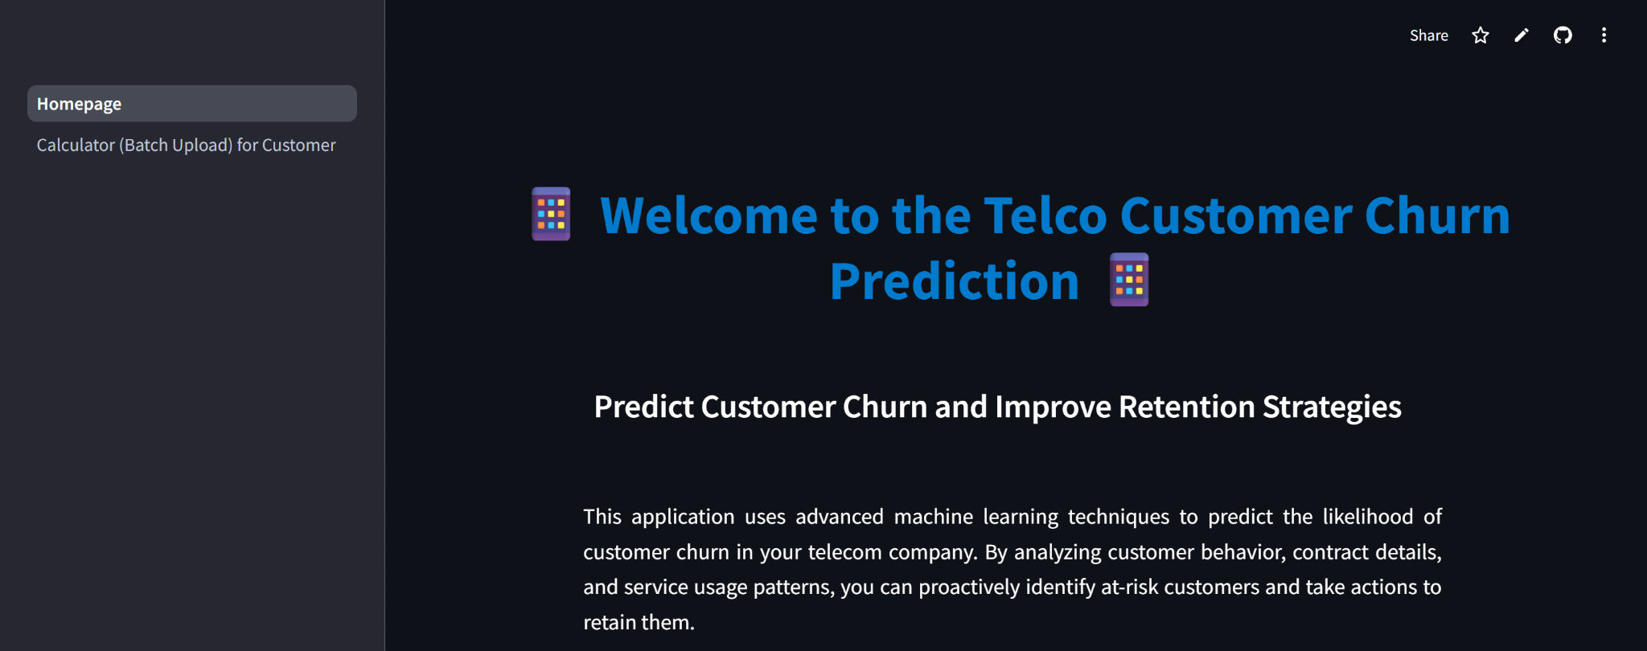
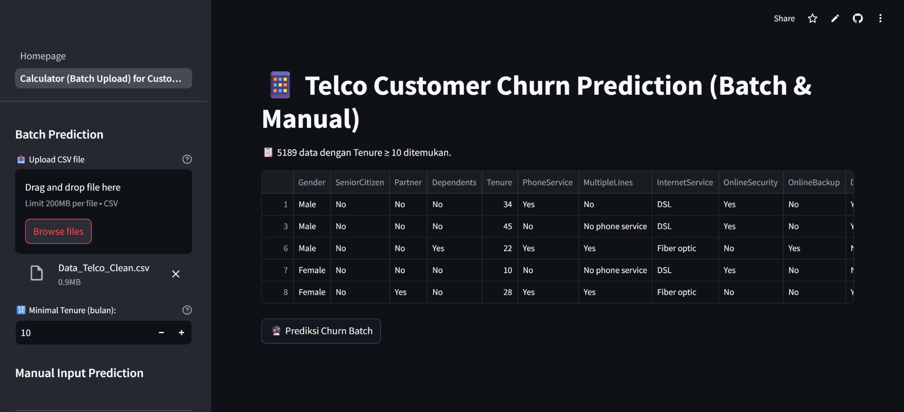
Strimlit Model

Slide 48
Thank you

